Slide 1

Introduction to
Boaghi Egor

Slide 2

Overview
What is CoffeeScript?
How it started?
Key Features?
What does it have common with ES2015?
What’s next?
Are there Downsides?
Conclusions?

Slide 3
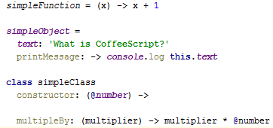
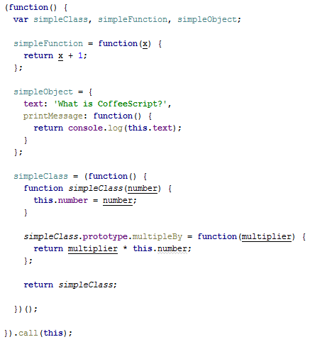
What is CoffeeScript?
Notes:
The original idea was for CoffeeScript to be "unfancy JavaScript" -- JavaScript boiled down to its regular essence without the language quirks you usually have to watch out for. Java is just a fancy word for coffee, so unfancy JavaScript is CoffeeScript.
CoffeeScript is a little language that compiles into JavaScript. CoffeeScript is an attempt to expose the good parts of JavaScript in a simple way.
The golden rule of CoffeeScript is: “It’s just JavaScript”. The code compiles one-to-one into the equivalent JS, and there is no interpretation at runtime. You can use any existing JavaScript library seamlessly from CoffeeScript (and vice-versa). The compiled output is readable, pretty-printed, and tends to run as fast or faster than the equivalent handwritten JavaScript.
The CoffeeScript compiler goes to great lengths to generate output JavaScript that runs in every JavaScript runtime, but there are exceptions. Use generator functions, for…from, or tagged template literals only if you know that your target runtimes can support them. If you use modules, you will need to use an additional tool to resolve them.

Slide 4
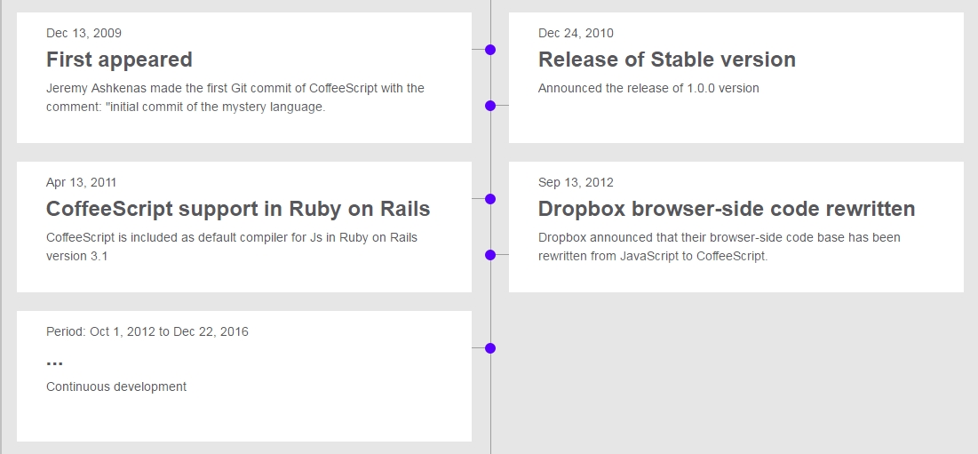
How it started?

Slide 5
Key Features?
Syntactic Sugar inspired by Ruby, Python and Haskell
Lexical Scoping and Variable Safety
Loops and Comprehensions
Array Slicing and Splicing with Ranges
etc.
Notes:
1) Some examples will be preffered( no semicolons, minimum of paranthesis)
2) The CoffeeScript compiler takes care to make sure that all of your variables are properly declared within lexical scope — you never need to write var yourself.
3) Most of the loops you’ll write in CoffeeScript will be comprehensions over arrays, objects, and ranges. Comprehensions replace (and compile into) for loops, with optional guard clauses and the value of the current array index. Unlike for loops, array comprehensions are expressions, and can be returned and assigned.
4) Ranges can also be used to extract slices of arrays. With two dots (3..6), the range is inclusive (3, 4, 5, 6); with three dots (3...6), the range excludes the end (3, 4, 5). Slices indices have useful defaults. An omitted first index defaults to zero and an omitted second index defaults to the size of the array.
5) The CoffeeScript compiler tries to make sure that all statements in the language can be used as expressions. Watch how the return gets pushed down into each possible branch of execution in the function below.
6) CoffeeScript’s existential operator ? returns true unless a variable is null or undefined

Slide 6
What does it have common with ES2015?
Arrow functions
Classes Syntax
Destructuring Assignment
Default Parameter Values
Splats(…)

Slide 7
Are there Downsides?
Additional layer of complexity
Compiling process
For optimal usage it is required to know both JavaScript and CoffeeScript
Doesn’t provide support for all ES2015 features

Slide 8
What’s next?
CoffeeScript 6
CoffeeScript 2
Support for ES2015 in CoffeeScript 1.x
Notes:
CoffeeScript 2 Es2015 support: 1) CS Classes will be transpilled in Es2015 classes syntax
2) Fat arrows => output as =>
3) Block assignment let and const
Etc.
CoffeeScript 1.x support Es2015 features(some are not transpilled):
Generator functions
Tagged Template Literals
Modules import and Export

Slide 9

Conclusions?

Slide 10

Thank You for Your Attention

